Slide 1

Call Center Performance Analysis
by. Rowida Taher

Slide 2






Agenda
Introduction
Data Overview
Data Processing
Visualizations
Key Insights & Recommendations

Slide 3

Introduction: Why a Call Center Dashboard?
Call centers are the frontline of customer interaction, handling thousands of conversations daily. Effectively monitoring this high volume of activity is crucial for maintaining service quality and operational efficiency. A centralized dashboard provides the visibility needed to track critical KPIs like call volume, response times, and customer satisfaction.
This enables our teams to make agile, real-time operational adjustments and informs our long-term strategic planning, ensuring we consistently meet and exceed customer expectations.

Slide 4
Data Overview: Sources & Metrics
Our dashboard consolidates data from various essential sources to provide a holistic view of performance. This includes:
Customer Feedback (CFM) Data
Contains Customer satisfaction scores (CSAT).
Fields: Agent ID, Date, CSAT Score.
Used to evaluate customer satisfaction trends by agent, work type, and time period.
Productivity Data
Tracks operational performance metrics.
Fields: Agent ID, Date, LOB, Answered Calls, Handle Time.
Used to calculate AHT (Handle Time ÷ Answered Calls) as the main productivity marker.
Active Agent List
Provides agent attributes and hierarchy.
Fields: Agent ID, Team Leader, Supervisor, Work Mode (WFH/WFO).
Enables segmentation and filtering in analysis.

Slide 5
Data Preprocessing & Transformation
Ensuring the accuracy and reliability of our data is paramount. Our robust data processing pipeline focuses on cleaning and transformation to prepare raw call logs for analysis:
Data Cleaning
Date & Time Processing
Converted data types (Date → Date, Numeric fields → Number).
Extracted Year-Week, Month and Number of Week from Date for trend analysis.
Removed blanks and ensured consistency across all datasets.
Prepared Daily, Weekly, Monthly aggregations for flexible reporting.
1
2
3
Data Relationships
Created relationships between fact tables (CFM, Productivity, Active List) and dimension tables (Agents, Calendar).
Established a Work Mode table (WFO, WFH).

Slide 6
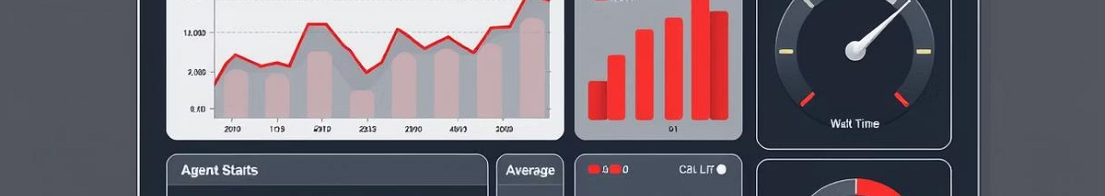
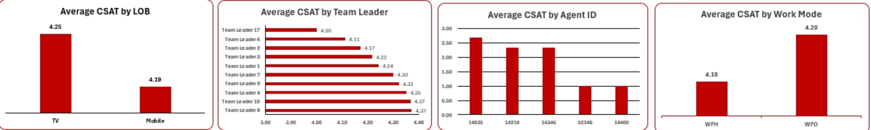
Visualization:
Average CSAT Analysis by Agent ID, line of business, Team Leader and Work Mode.

Slide 7
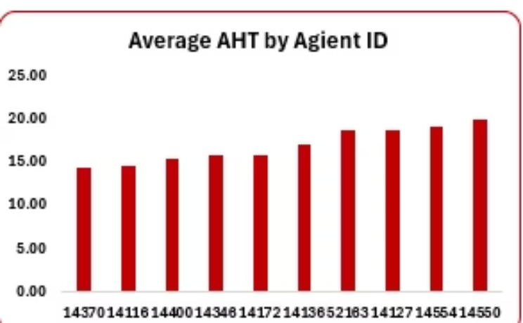
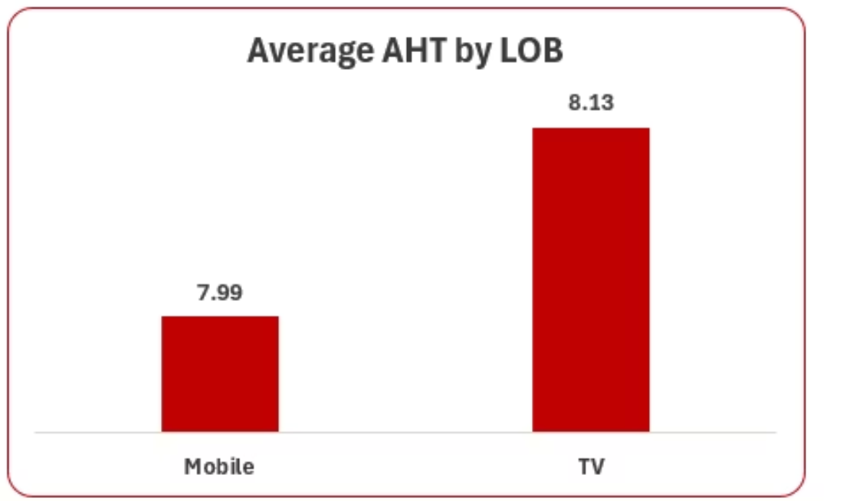
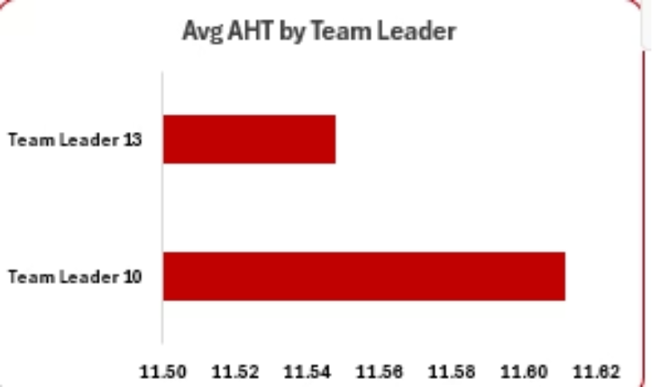
Visualization :
AHT Analysis by Agent ID, Line of business, Team Leader.
Average Handle Time (AHT) by Team Leader:
Analysis shows that Team Leader 10 has a higher average AHT compared to Team Leader 13.
This indicates that calls handled under Team Leader 10’s team take longer on average.

Slide 8
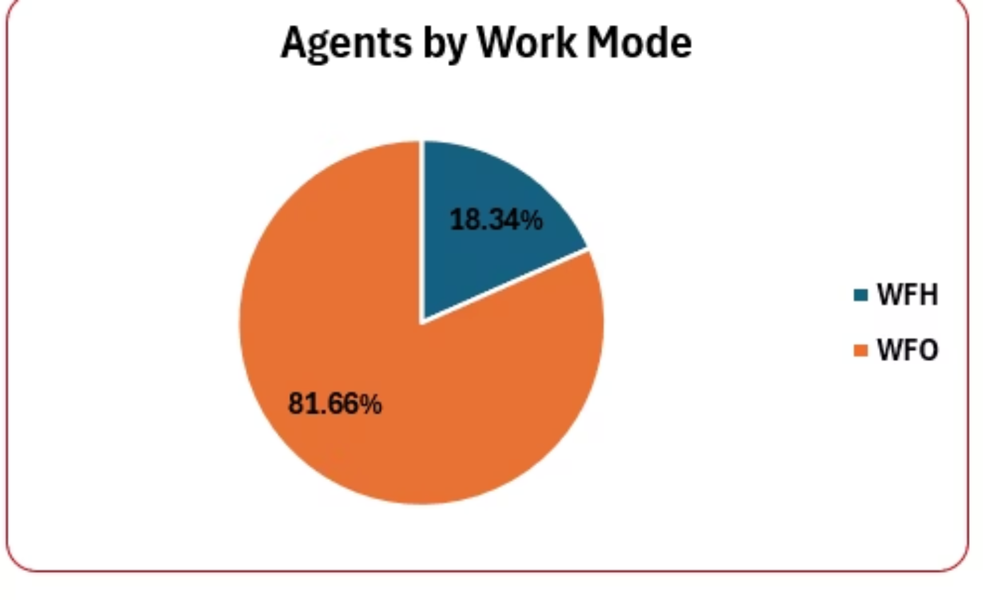
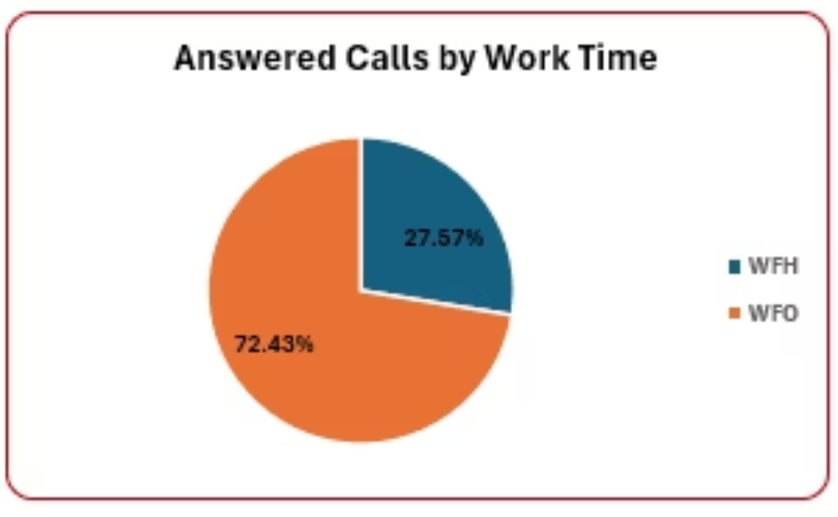
Visualization :
WFO agents handle the majority of calls: 72.43% of total answered calls.
WFH agents contribute 27.57% of total answered calls.
Although only 18% of agents are WFH, they manage more than a quarter of the call volume .
Out of the total active agents %18.34(≈ 42 agents ) are working from home (WFH).
The majority, %81.66(≈187 agents ) are working from office (WFO).
This distribution highlights that most of the workforce is office-based, with a smaller proportion operating remotely.

Slide 9
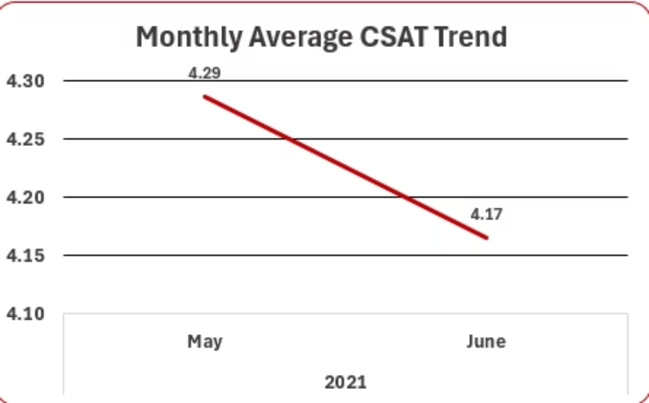
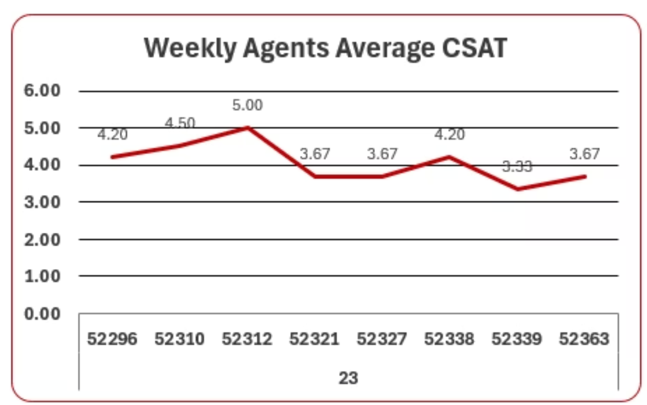
Visualization :
Weekly Average CSAT (Week 23)
In Week 23, Client ID 52321 achieved the highest average CSAT score of 5.00.
The average CSAT in May was 4.29, showing relatively higher customer satisfaction.
In contrast, Client ID 52339 recorded the lowest average CSAT score of 3.33.
In June, the average CSAT slightly decreased to 4.17.
This downward movement suggests a small dip in customer satisfaction, highlighting the need to monitor service quality and agent performance closely.
This variation highlights performance differences among agents, indicating opportunities to identify best practices from high performers and address service gaps with low performers.

Slide 10
Key Insights:
Average CSAT for Team Leader 8 and Team leader 10 is (4.37),the top 2 team leaders by avg CSAT.
The bottom 2 agents ids(52164 and 14400) have avg CSAT 1,means that customers is highly dissatisfied with their service , compared to the
top agents(CSAT=5) it highlights a significant performance.
The top three agent IDs(52172,52339,52209) handled above 9900 calls.
Agent id 52172 has %Occupancy (100%),he is handling a heavy workload and busy all the time .
Month May had the highest avg CSAT 4.29.
Average CSAT for WFO IS 4.20 and WFH is 4.18 ,showing consistently high customer satisfaction across both work modes.
Agent id (14550) has average AHT =19.80 compared to the overall Average AHT =7.03,he is significantly slower than peers .
18.34% of agents are working from home but 81.66 are working from office , showing that the majority of workforce is office-based.

Slide 11
Kpi:
Overall Average CSAT Score is 4.01.
Overall Average AHT(in mins) is 7.01
Number Of Active Agents is 231
Total Answered Calls is 873k

Slide 12
Recommendations:
Review and resolve “N/A” assignments to ensure all agents are mapped to the correct team leader.
Monitor workload balance to prevent burnout and maintain stable performance.
Standardize break times across all work modes to ensure fairness and consistency.
Strengthen infrastructure to support Work From Home (WFH) agents and consider scaling the model.
Provide targeted leadership training for team leads showing weak CSAT trends.

Slide 13

Thank you
I appreciate your time and attention. Do you have any questions?

